Slide 1
Colors
Ashwin Malshe, PhD

Slide 2
https://www.youtube.com/watch?v=iPPYGJjKVco

Slide 3
Trichromatic Theory
Normal color vision is based on the activity of three types
of receptors, each with a different peak sensitivity.

Slide 4

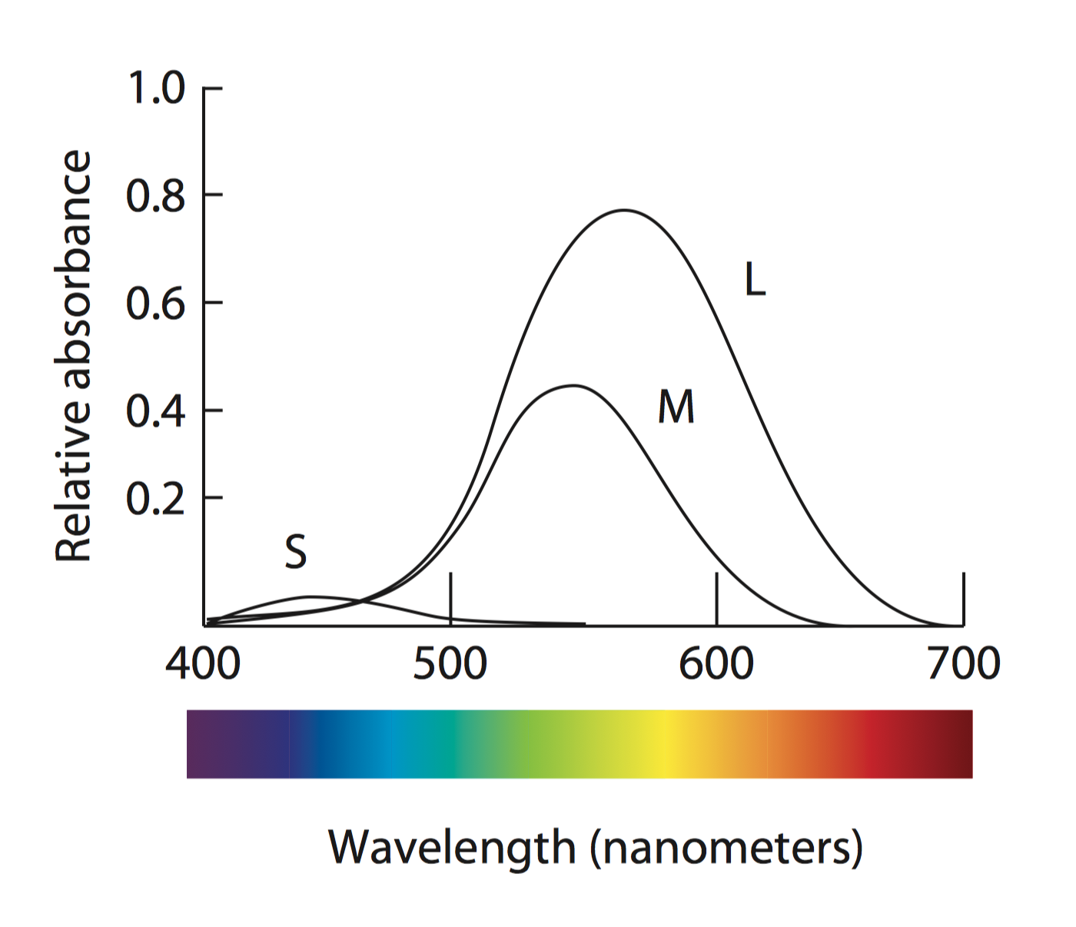

Slide 5

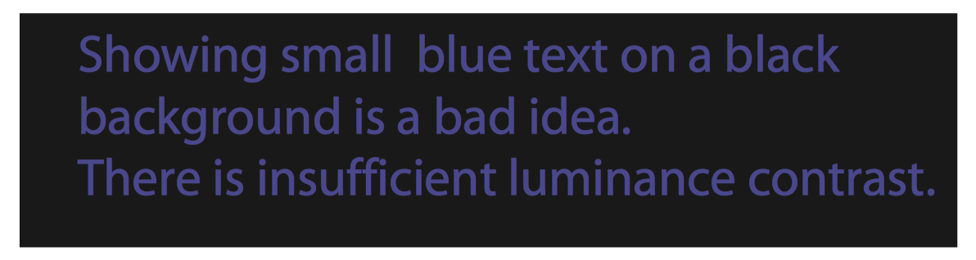

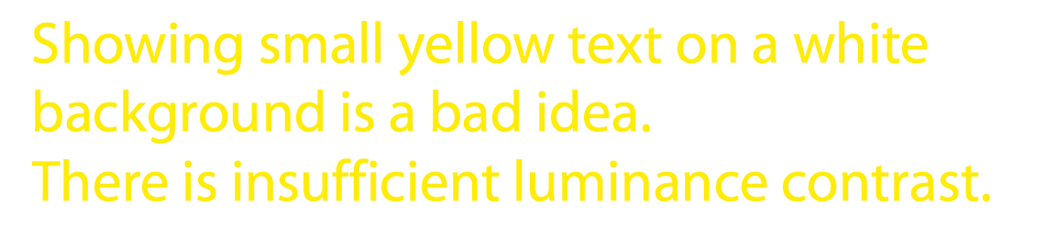
Why is this so Hard to Read?

Slide 6

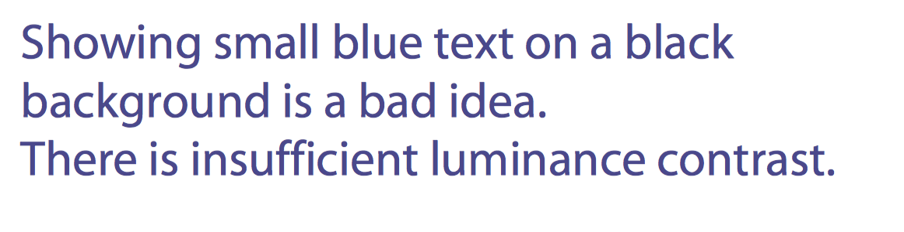

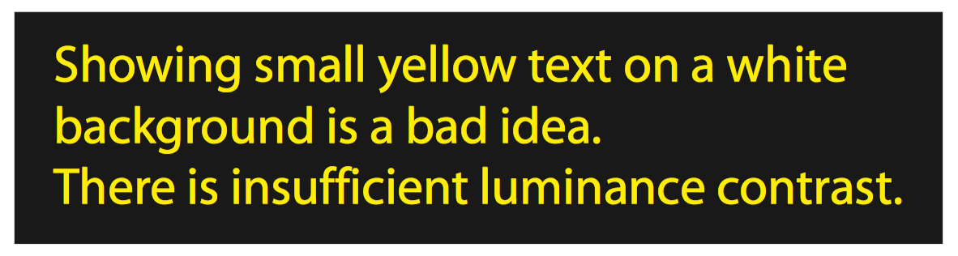
Or why is this so Easy to Read?

Slide 7
There are far fewer blue cones than green or red cones
(only about 5% blue cones)

Slide 8

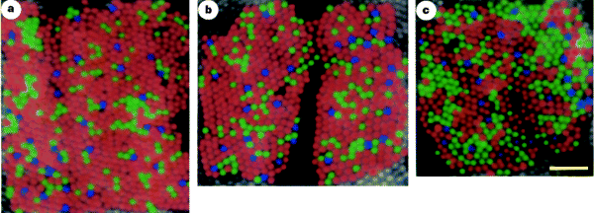
From the following article:
The arrangement of the three cone classes in the living human eye
Austin Roorda and David R. Williams
Nature 397, 520-522(11 February 1999)
doi:10.1038/17383

Slide 9
A Few Implications
Taken from “Visual Thinking for Design” by Prof. Colin Ware
https://www.amazon.com/gp/product/B006NVY448/ref=dbs_a_def_rwt_bibl_vppi_i0

Slide 10




Brightness Contrast
Chromatic Contrast

Slide 11


Sensitivity to Spatial Detail

Slide 12
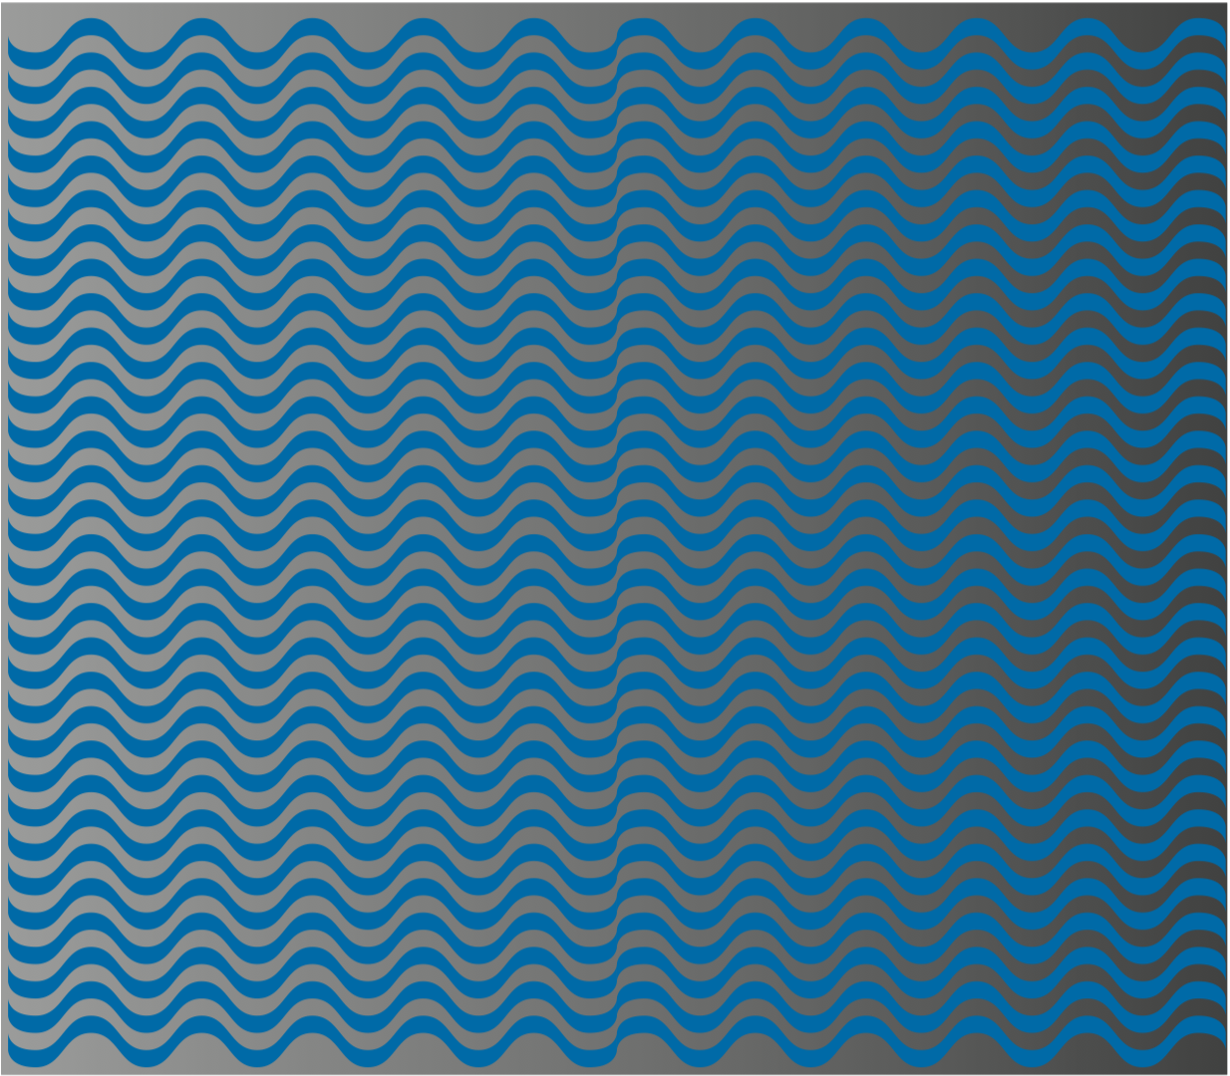

Slide 13

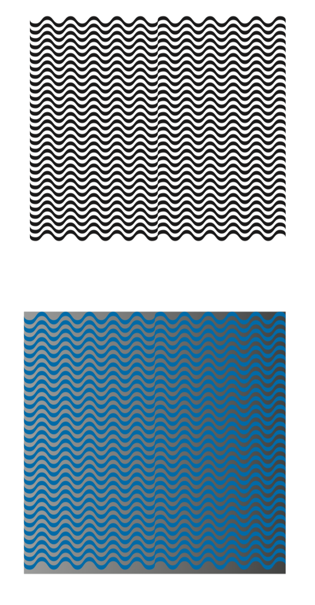

Slide 14


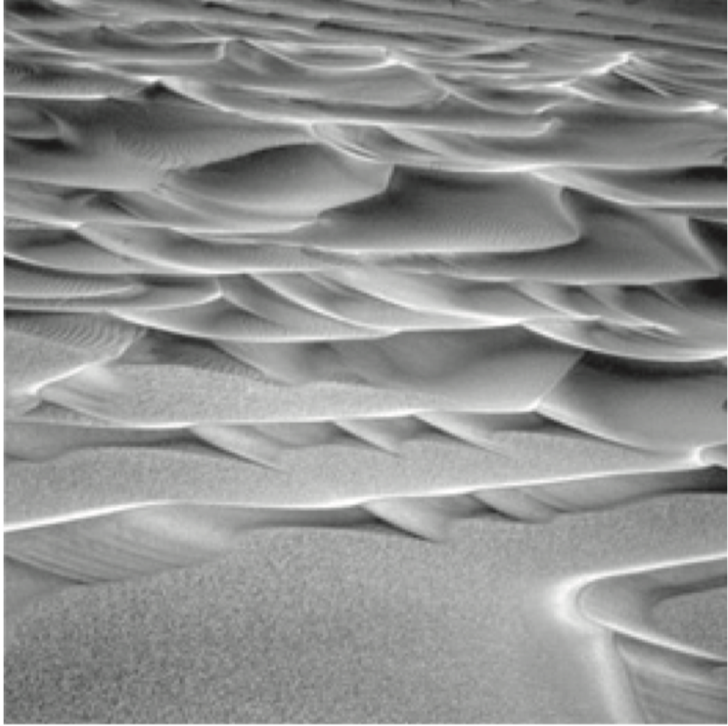
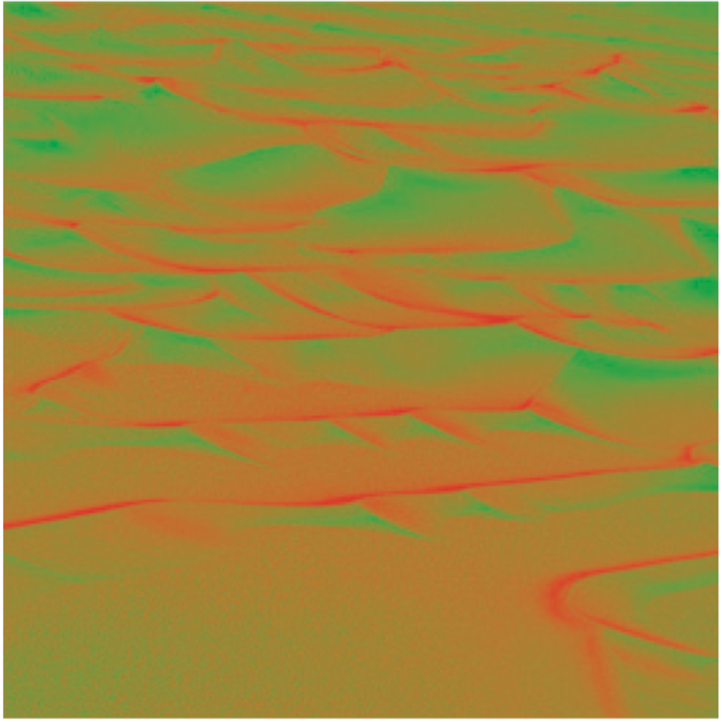
Shape from Shading

Slide 15

Sharpening

Slide 16


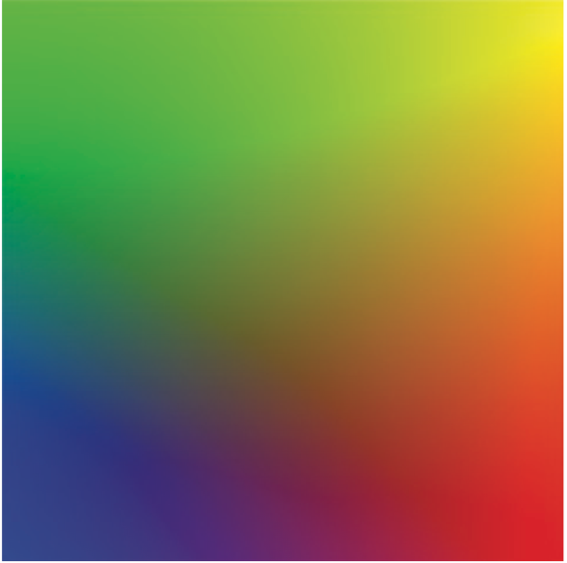
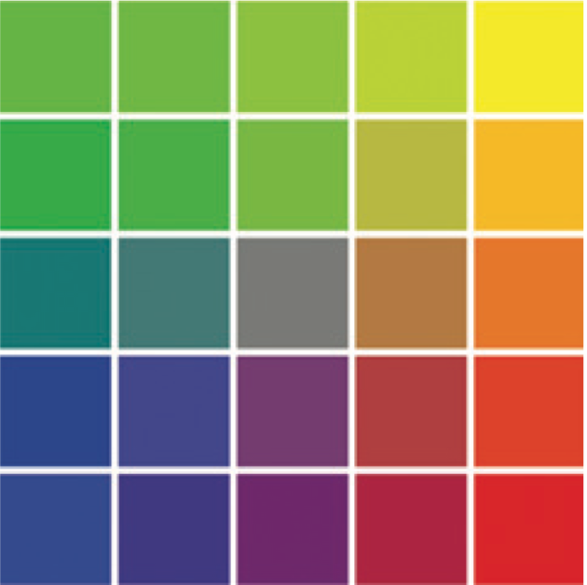
Color Segmentation

Slide 17


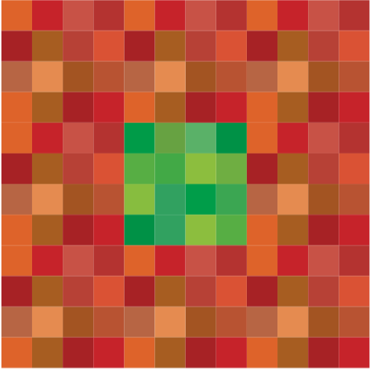
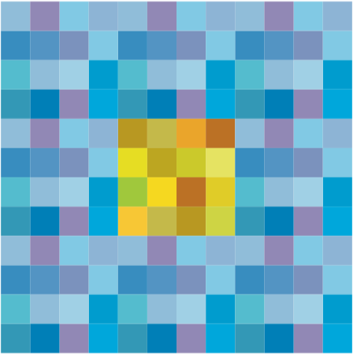


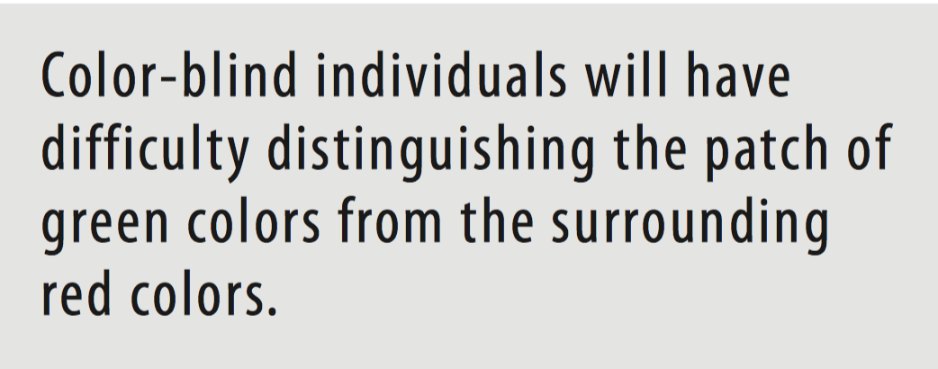
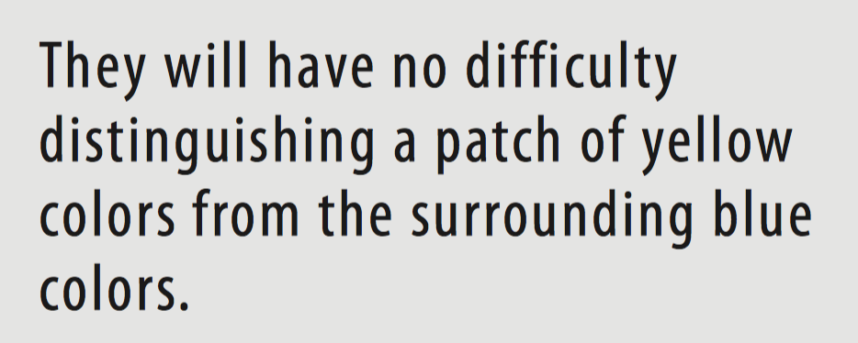
Color Blindness

Slide 18
Design Implications

Slide 19

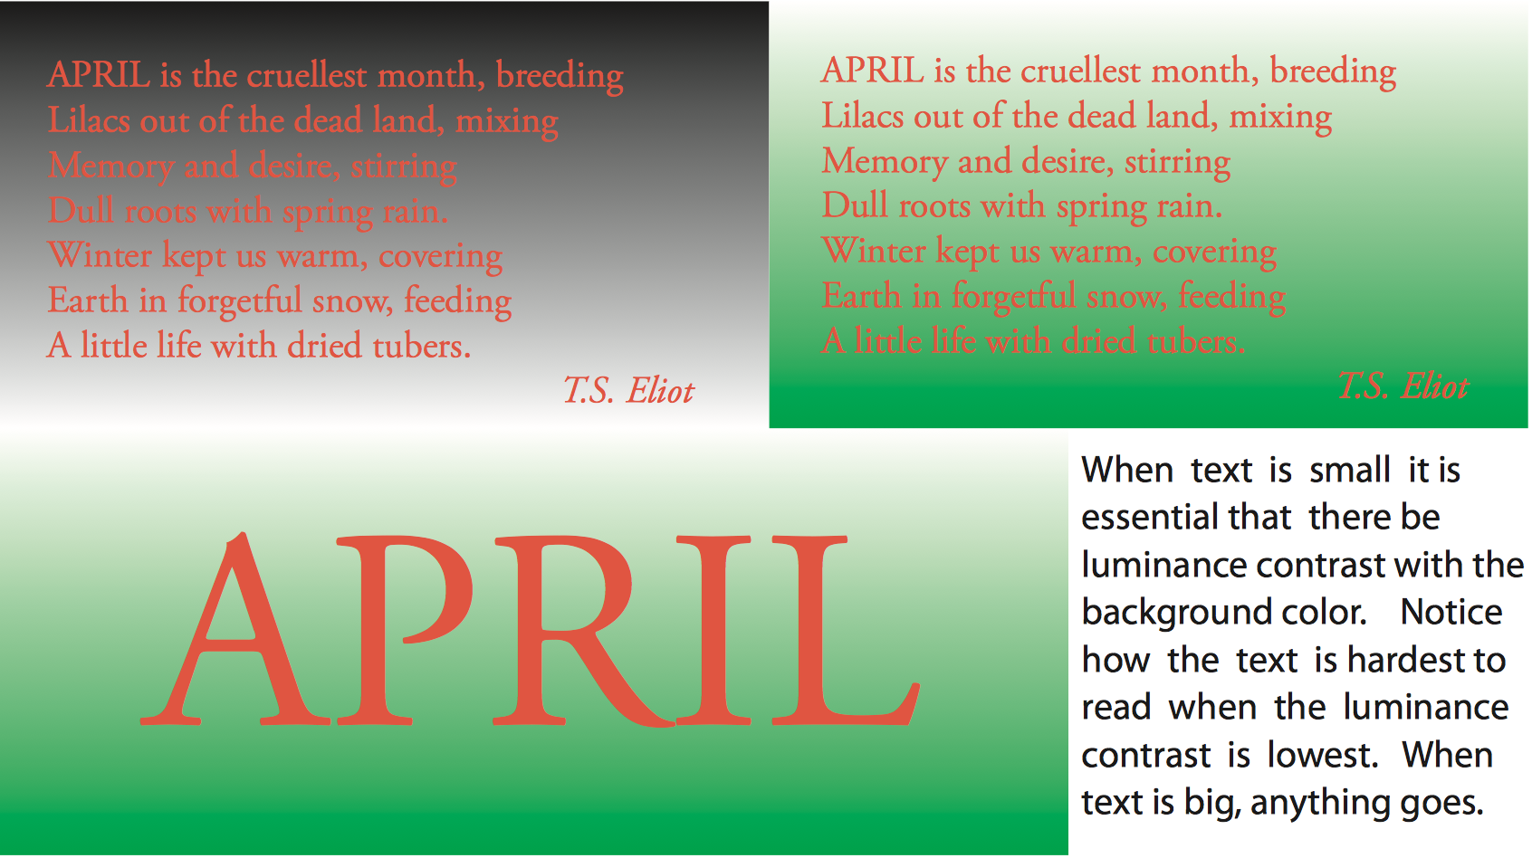
Showing Detail
The International Standards Organization (ISO)
recommends a ratio of at least 3:1 between
the luminance of text and the luminance of the background.

Slide 20

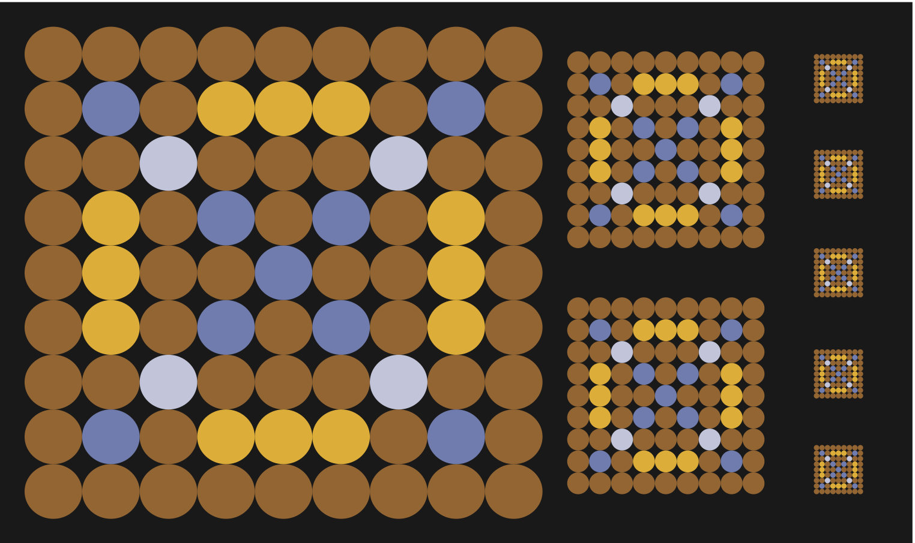

Slide 21
Color Coding Information
Although there may be quite large individual differences in how people perceive colors, when it comes to labeling them with words we appear to have a shared system
How many colors can be used reliably in a symbol set?
The number of colors recommended is between 6 and 12 according to various studies

Slide 22

In the design of color codes, the two primary considerations must be
visual distinctness, to support visual search operations, and
learnability, so that particular colors come to “stand for” particular entities
When learnability is the issue, it is important to use the unique hues ﬁrst—red, green, yellow, and blue—followed by other colors that have relatively consistent names: pink, brown, orange, grey, and purple

Slide 23

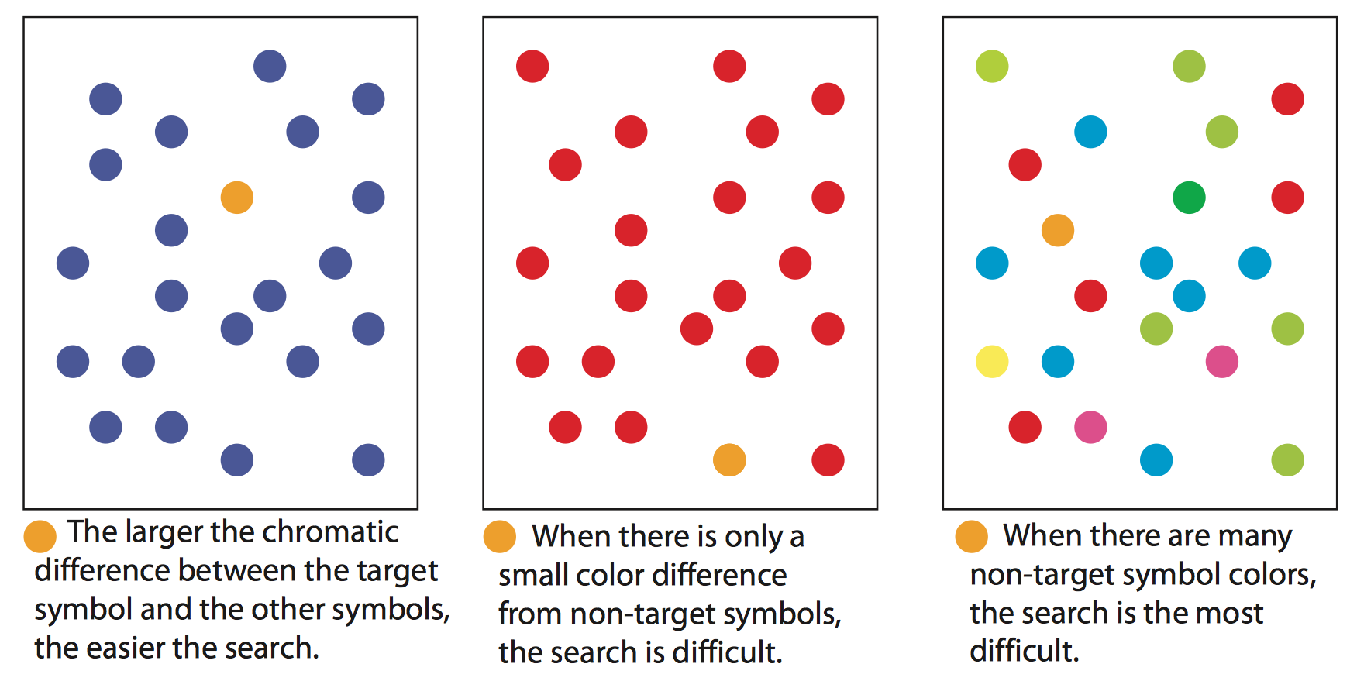

Slide 24

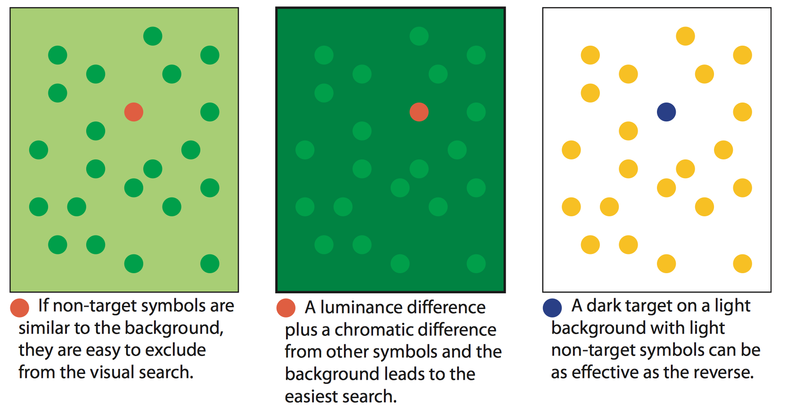

Slide 25

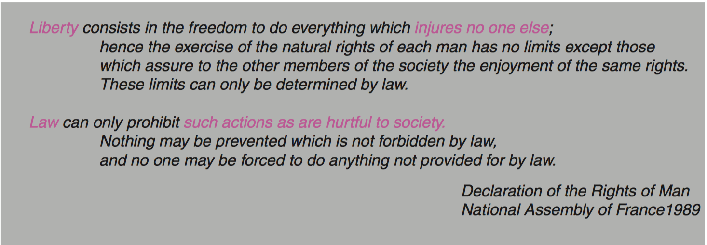
What’s the Problem?

Slide 26

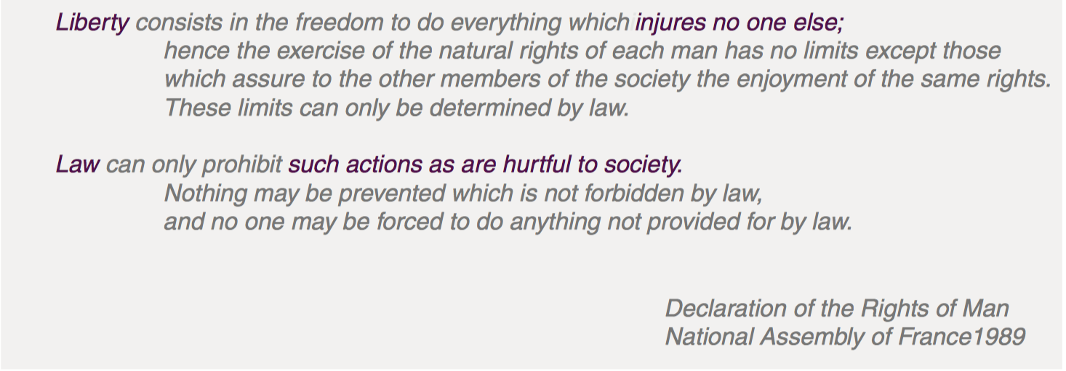

Slide 27
Color Sequence
Color sequence are used in maps
e.g., show cold temperature with blue color and hot with red or orange color
It’s best to provide a sequence that spirals up through color space, starting off with a dark color and selecting a series of colors, each of which has higher luminance than the previous one

Slide 28
Semantics of Color
Colors have different meanings in different cultures
White is color of mourning in many eastern countries while in western countries it’s black
A few colors have established meanings
Red is stop, green is go

Slide 29
For all but the simplest designs, the choice of a set of colors is a complex problem that typically involves tradeoffs
As a rule of thumb, the most common and most important visual queries should be given the most weight
The most distinctive hues should be reserved for the most commonly accessed symbols and patterns in a design

Slide 30
How Eyes Deceive Us
https://www.ted.com/talks/beau_lotto_optical_illusions_show_how_we_see
https://www.youtube.com/watch?v=mf5otGNbkuc

